Slide 1
Azure Application Gateway – Solutioning for External access
Date :08-11-2022

Slide 2
Topics
Overview and why Azure Application Gateway
Comparison of other LB services and AppGW workflow
Design approach and Solutioning for Multiple Patterns
AppGateway pre-requisite
Connectivity(NSG & DNS)
Migration readiness
Lessons learnt

Slide 3
Overview and why Azure Application Gateway
Azure Application Gateway is a web traffic load balancer that enables you to manage traffic to your web applications, especially when the application is exposed over the internet.
We had to solution the external app accessibility through different LB services( Application Gateway, Traffic manager and Front Door)
We opted for Application Gateway as it provides high-level secure network system communication which manages layer 7 traffic with WAF functionality similar to Front door.
Though Front Door and Application Gateway can both manage Layer 7 traffic, Front Door is a global load balancer while Application Gateway is a regional load balancer. This means that Front Door is better suited while you use multiple regions within your cloud.
Meanwhile, Application Gateway is better suited for those who want more granular control over how traffic is balanced within the same region. You can write rules that govern exactly how Application Gateway distributes traffic within a regional application environment
On broader design approach, Appservice is hosting the website and Appgateway acts as a proxy for the Appservice and enables the users outside customer network.

Slide 4
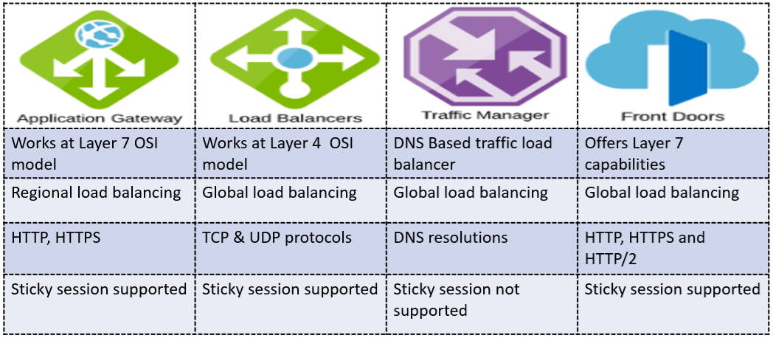
Comparison of other LB services
Below information will help you to choose service wisely:
If you want to load balance between your servers in a region at the application layer, review Application Gateway.
To do network layer load balancing, review Load Balancer.
If you are looking to do DNS-based global routing and do not have requirements for Transport Layer Security (TLS) protocol termination ("SSL offload"), per-HTTP/HTTPS request or application-layer processing, review Traffic Manager.
If you need to optimize the global routing of your web traffic and optimize top-tier end-user performance and reliability through quick global failover, see Front Door.

Slide 5
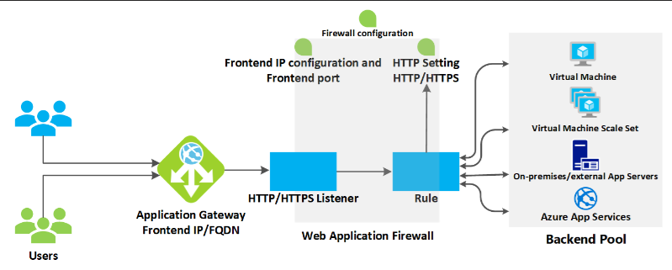
AppGW workflow

Slide 6
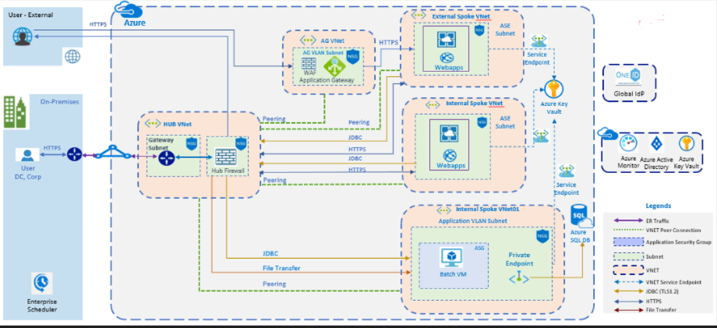
Architecture Design Pattern

Slide 7
Offerings - Azure Application Gateway Solutioning for Multiple Patterns
Pattern #1: Single App Service, shared between Internal users (access via ASE) and External users (via App GW) with same FQDN
Domain name | Actions Needed
www.abc.com(Private) | Bind SSL certificate to AppService
www.abc.com(Public) | SSL certificate must be signed by a DigiCert CA Bind the bundled cert to AppGW
Pattern #2: Dedicated App Service for Internal Users and external users respectively with different FQDN.
Domain name | Actions Needed
www.abc-internal.com(Private) | App Service#1: Bind SSL certificate to AppService
www.abc-external.com(Public) | App Service #2: SSL certificate must be signed by a DigiCert CA Bind the bundled public cert to AppGW Bind the public cert(.pfx) to AppService.
Pattern #3: Dedicated App Service for Internal Users along with shared App Service for Internal & external facing App Gateway
Domain name | Actions Needed
www.abc-internal.com(Private) | App Service #1: Bind SSL certificate to AppService
www.abc-external.com(Public) www.abc-external.com(Private) | App Service #2: SSL certificate must be signed by a DigiCert CA Bind the Public bundled cert to AppGW Bind the Private cert(.pfx) to AppService.
Pattern #4: Single App Service, shared between Internal users (access via ASE) and External users (via App GW) with same FQDN
Domain name | Actions Needed
www.abc.com(Public) | SSL certificate must be signed by a DigiCert CA Bind the bundled cert to AppGW

Slide 8
AppGateway pre-requisite
Procure a dedicated Vnet/Subnet
Create a dedicated RG and AKV
Inline to customer naming standards, Create the AppGW and Managed Identity and ensure they both are under the same Subscription.
Application Gateway’s virtual network/Subnet should be configured in allowed access from firewall and virtual networks of AKV
Bundle the SSL cert with Digicert CA using SSL tool and add it to AppGW.

Slide 9
AppGateway- NSG and DNS
NSG connectivity:
Open the port 443 between AppGW’s subnet and ASE subnets.
Enable “Appgw Service Tag” to AppGW’s Subnet on TCP ports 65200 – 65535.
DNS requests:
External:
1. Create a A-record for the newly created AppGW using the Pip.
2. C-record to point the A-record(abc.contesso.com to point the AppGW)
Internal:
1. Internal C-record will point to Appservice dedicated to Internal users (abc-internal.contesso.com to point the ASE long url)

Slide 10
Migration readiness
Ensure the AppGW can connect the ASE subnets using connection troubleshoot for port 443.
AppGW’s Listener should have the Hostname pointing to the Application custom domain
Listener rules: Listener’s type is set to “multi site” and host type is “single” pointing to the actual FQDN.
HTTP setting: Ensure the digicert bundled cert(public) and Root CA cert are added.
HTTP setting: Ensure the Cookie based affinity is disabled.
Rewrite rule configuration – If & then condition to ensure the app url abc.contesso.com is reflecting while redirecting to the ASE.
Backend health is “Healthy” which denotes the ASE connectivity from AppGW through port 443

Slide 11
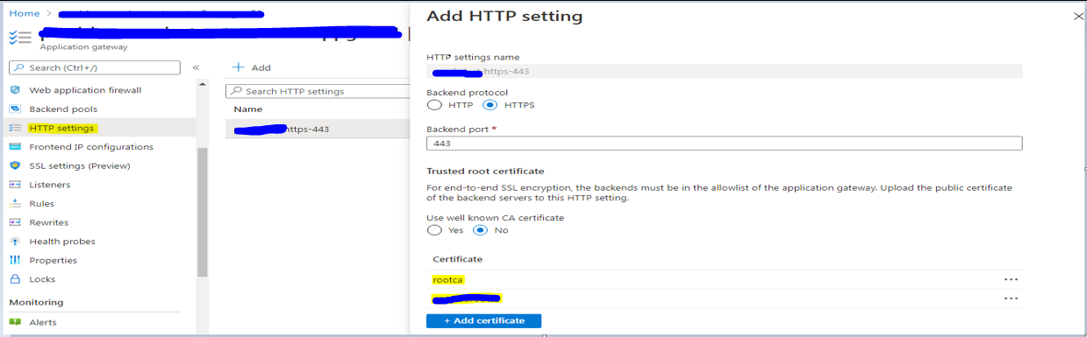
Lessons Learnt
Title | Description
Issue Description | Certificate mismatch between AppService and AppGateway: .
Problem summary | As a default process, we paced only the binding of external CA certificate which led to AppGW HC with errors and logs depicting unauthorized backend
Fix | The addition of Root CA cert along with bundled public cert to AppGW’s HTTP setting fixed the error.

Slide 12
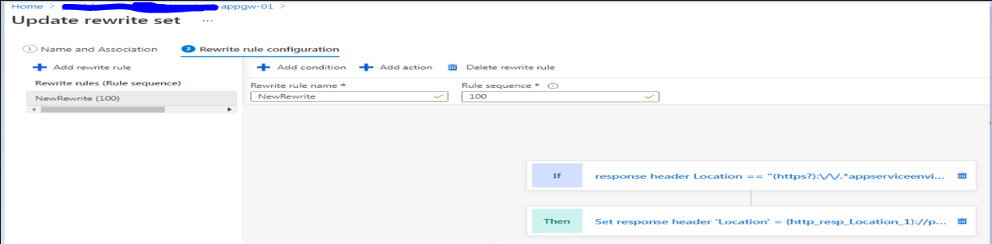
Lessons Learnt
Title | Description
Issue Description | Application’s Custom domain was not maintained/persisted while return from PingFed handshake especially while accessing through Internet.
Problem summary | During this PingFed handshakes, the HTTP headers got changed which led to replacement of custom domain to Appservice default domain
Fix | Microsoft suggested to make Rewrite rule configuration (If & Then) condition to rewrite HTTP headers and maintain the custom domain URL during handshake.

Slide 13
Q&A

